Slide 1
Group 1, Team 3
Nikita Narwal
Meenakshi Goyal
Gautam

Slide 2
Queue

Slide 3
What is Queue?
Queue is a Linear Data Structure that works on the principle of First In First Out(FIFO).
The first element is inserted from one end called the REAR(also called tail), and the removal of existing element takes place from the other end called as FRONT(also called head).
Unlike stacks, a queue is open at both its ends. One end is always used to insert data (enqueue) and the other is used to remove data (dequeue).

Slide 4
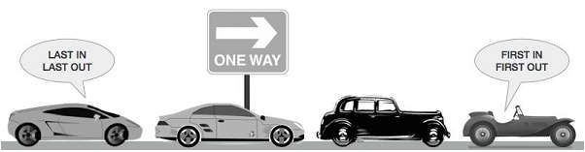
One end is always used to insert data (enqueue) and the other is used to remove data (dequeue).
A real-world example of queue can be a single-lane one-way road, where the vehicle enters first, exits first.

Slide 5
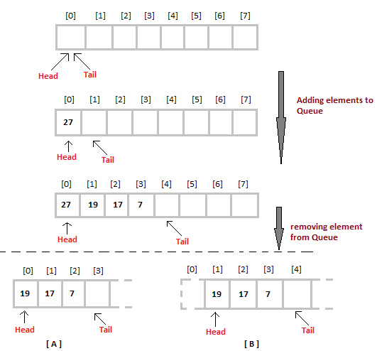
Implementation of Queue

Slide 6
Operation on Queue

Slide 7
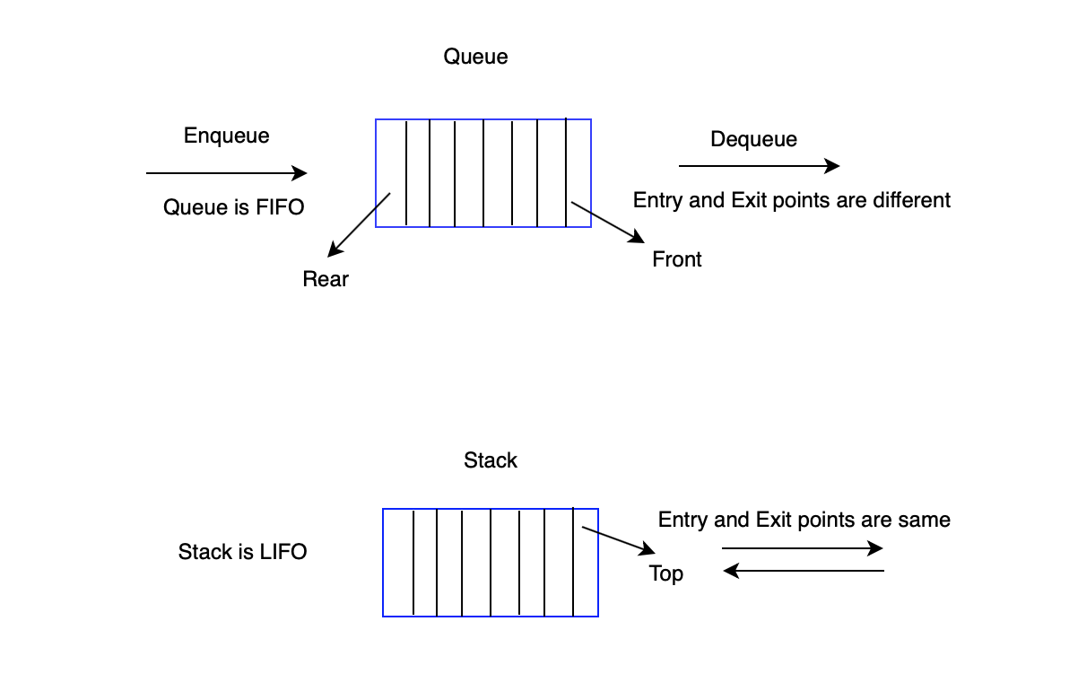
Main Operation

Slide 8
Basic operations
enqueue() − add (store) an item to the queue.
dequeue() − remove (access) an item from the queue.
peek() − Gets the element at the front of the queue without removing it.
isfull() − Checks if the queue is full.
isempty() − Checks if the queue is empty.

Slide 9
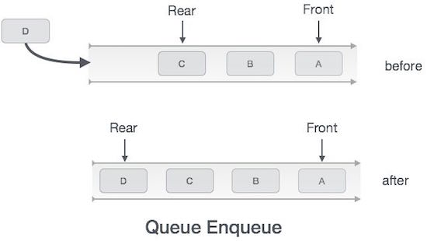
Enqueue Operation
Step 1 − Check if the queue is full.
Step 2 − If the queue is full, produce overflow error and exit.
Step 3 − If the queue is not full, increment rear pointer to point the next empty space.
Step 4 − Add data element to the queue location, where the rear is pointing.
Step 5 − return success.

Slide 10
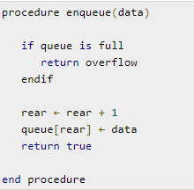
Algorithm for EnQueue

Slide 11
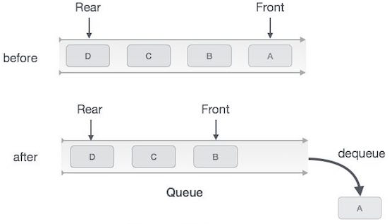
DeQueue Operation
Check if the queue is empty or not.
If the queue is empty, then print underflow error and exit the program.
If the queue is not empty, then print the element at the head and increment the head.

Slide 12
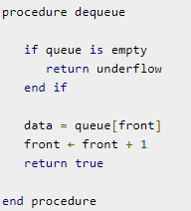
Algorithm for DeQueue

Slide 13
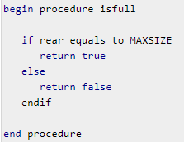
Algorithm for isFull Operation

Slide 14
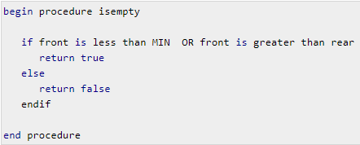
Algorithm for isEmpty Operation

Slide 15
Applications

Slide 16
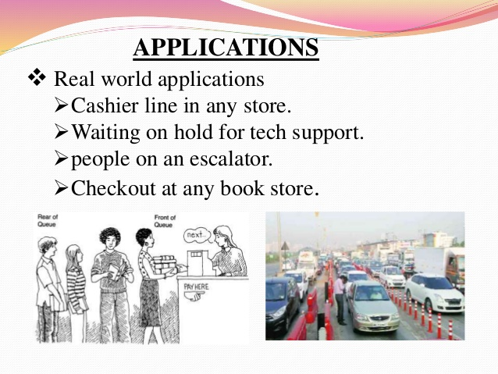
Real life Applications

Slide 17
Applications in Computer Science
Queue is useful in CPU scheduling, Disk Scheduling. When multiple processes require CPU at the same time, various CPU scheduling algorithms are used which are implemented using Queue data structure.
When data is transferred asynchronously between two processes.Queue is used for synchronization. Examples : IO Buffers, pipes, file IO, etc.
Breadth First search in a Graph .
Handling of interrupts in real-time systems. The interrupts are handled in the same order as they arrive, First come first served.

Slide 18
Types of Queues

Slide 19

Simple Queue
Circular Queue
Priority Queue
Dequeue

Slide 20
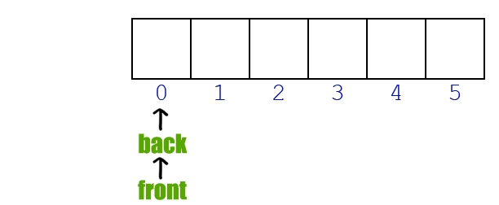
Simple Queue
Simple queue defines the simple operation of queue in which insertion occurs at the rear of the list and deletion occurs at the front of the list.

Slide 21
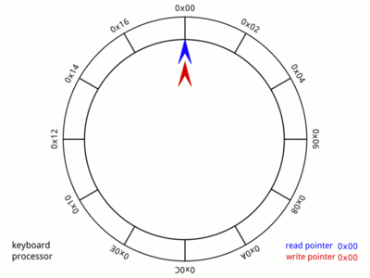
Circular Queue
Circular Queue is a linear data structure in which the operations are performed based on FIFO (First In First Out) principle and the last position is connected back to the first position to make a circle. It is also called ‘Ring Buffer’.

Slide 22
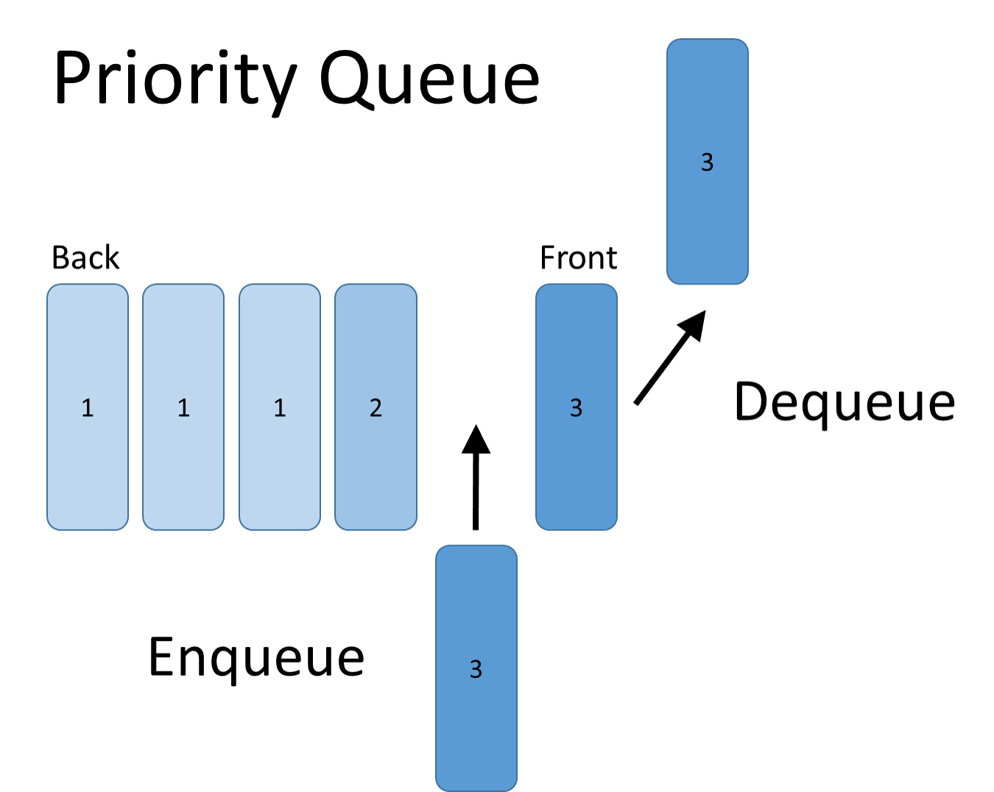
Priority Queue
A priority queue is a very important data structure because it can store data in a very practical way. This is a concept of storing the item with its priority. This way we can prioritize our concept of a queue.

Slide 23
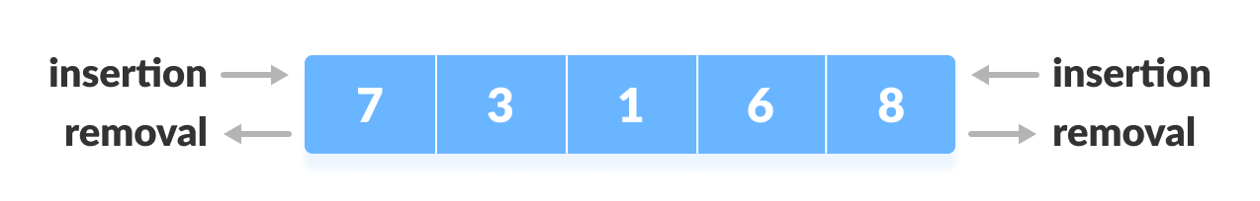
DeQue
Deque or Double Ended Queue is a type of queue in which insertion and removal of elements can be performed from either from the front or rear. Thus, it does not follow FIFO rule (First In First Out).

Slide 24
Types of DeQue
Input Restricted
Output Restricted

Slide 25
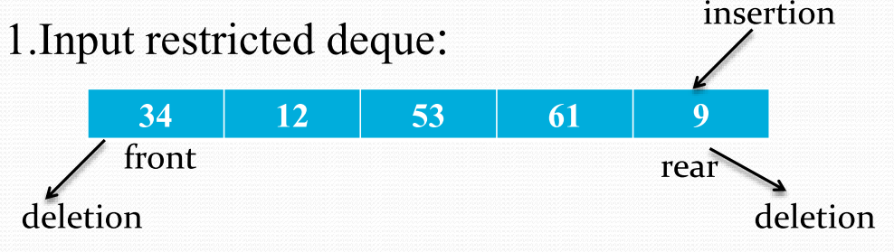
Input Restricted DeQue
In this deque, input is restricted at a single end but allows deletion at both the ends.

Slide 26
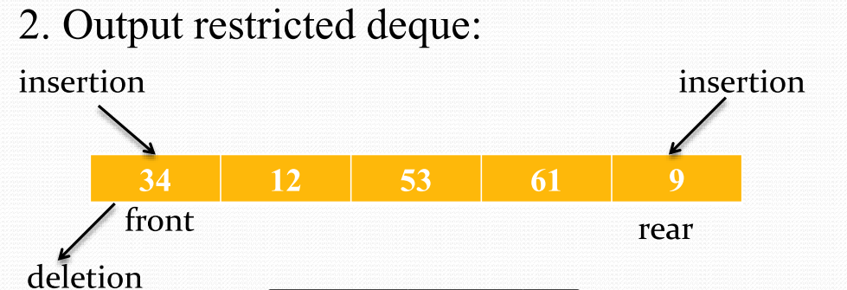
Output Restricted DeQue
In this deque, output is restricted at a single end but allows insertion at both the ends.

Slide 27

End

Slide 28

Any Questions????

